Slide 1
ONAP – Automation for Telco’s
KRANTHI

Slide 2
Why Open Network Automation Platform (ONAP)?
Incomplete or old-school solutions did not meet requirements:
Automation requires design, network service lifecycle management and service assurance - all working together
Agility requires new and innovative approaches (see next chapter)
Automation further requires the ability to create analytics and AI/ML (Artificial Intelligence/Machine Learning) applications
Upcoming 5G and IoT (Internet of Things) trends require the ability to serve edge and core use cases, including multi-access edge computing (MEC) applications.

Slide 3
Cont..
Prior products/projects did not have enough momentum to drive:
Standardized VNF onboarding mechanisms, along with testing and validation
Cloud native VNFs
Network service lifecycle design and management
Service assurance
Standardization of model-driven languages.

Slide 4
Cont..
Open source projects have an ability to execute a code-first approach from an API and interface specification point of view. This is in contrast to ETSI, MEF (Metro Ethernet Forum) or TM (TeleManagement) Forum standardization efforts that may be restrictive and may not be able to keep up with the rapid pace of innovation. In other words, early on, an open source method of creating standards may be more efficient than that of traditional standard bodies.

Slide 5
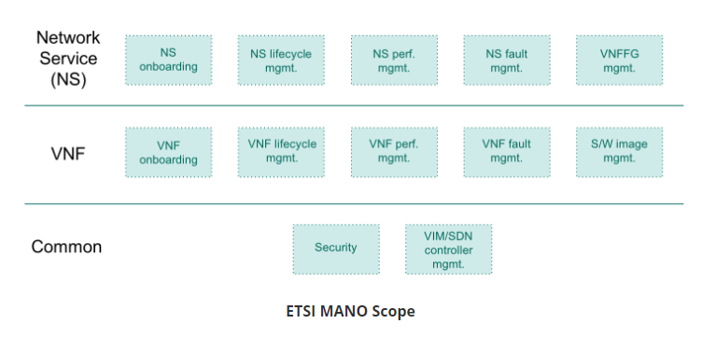
ETSI MANO Scope

Slide 6
Evolution of ONAP
ONAP resulted from the merger of two open source projects: OpenECOMP and Open-O.
AT&T had an internal network automation project called Enhanced Control, Orchestration, Management, and Policy (ECOMP) that was open sourced under The Linux Foundation in late 2016/early 2017

Slide 7
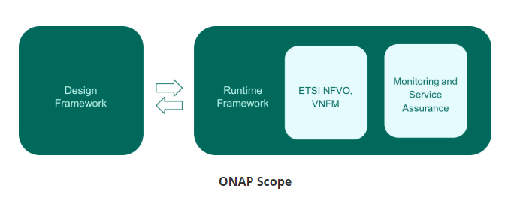
ONAP Scope

Slide 8
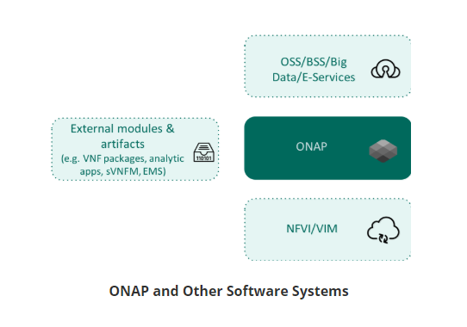
ONAP & Other softwares

Slide 9
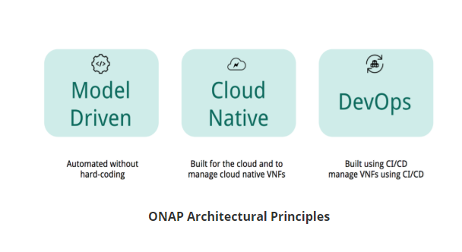
ONAP Primary Architectural Principles

Slide 10
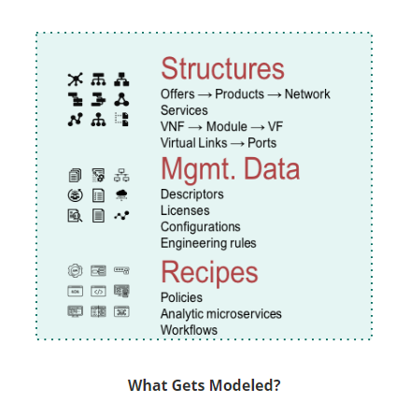
ONAP Architectural Principles: Model Driven:

Slide 11
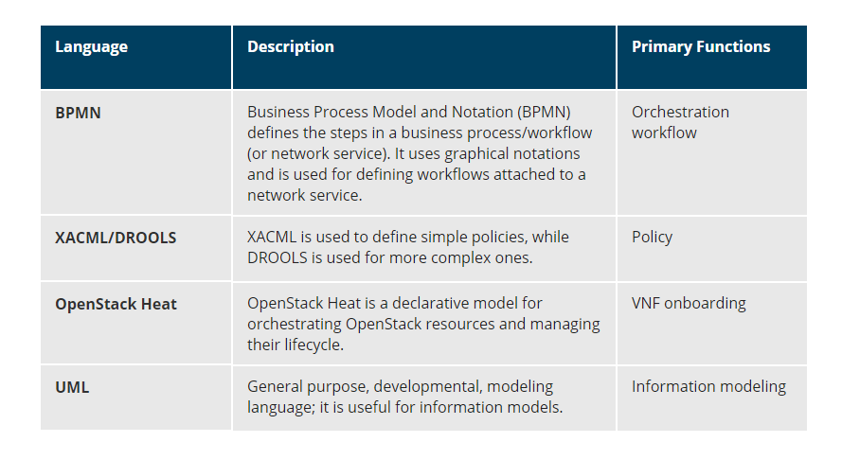
Model Driven - Other Modeling Languages

Slide 12
ONAP Architectural Principles: Cloud Native
Cloud native is a modern software architecture with the following key principles:
Virtualized infrastructure resources
Shared standard cloud platform
Microservices/decoupled single capability modules with open APIs
Separate of stateful and stateless microservices; common data layer and information models
Scale-out instead of scale-up; availability will become part of the application, instead of the infrastructure; failure of individual VNFs is expected, and handled with scale-out HA
Backwards compatible
Secure, reusable, and antifragile.

Slide 13
ONAP Architectural Principles: DevOps
DevOps as continuous delivery of small incremental changes to software applications via automation, as opposed to large multi-month changes. DevOps delivers innovations to users rapidly and, contrary to intuition, in a less risky manner than large step-function changes.

Slide 14
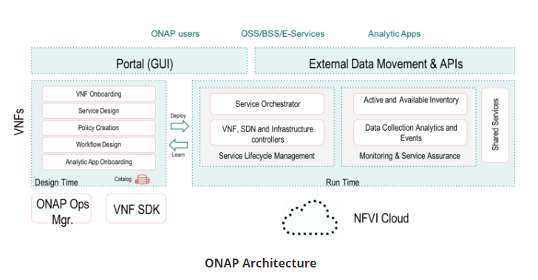
ONAP Architecture

Slide 15
Design time environment module
The design time environment module is responsible for:
VNF on-boarding/validation
Network service/SDN service design
Policy creation
Workflow design
Analytics application onboarding.

Slide 16
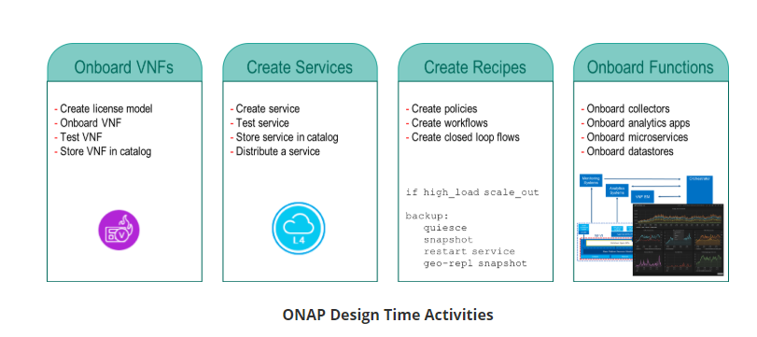
ONAP Design Time Environment

Slide 17
ONAP Graphical Tools
These activities are supported by two graphical tools:
Service Design and Creation (SDC)
Closed/Control Loop Automation Management Platform (CLAMP).

Slide 18
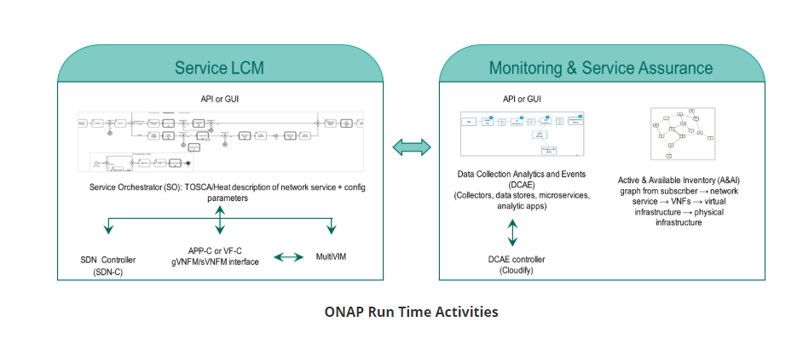
ONAP Run Time Environment

Slide 19
Cont..
Service orchestration and lifecycle management consists of:
Service Orchestrator (SO)
SDN Controller (SDN-C)
Application Controller (APP-C) and Virtual Function Controler (VF-C) — Virtual Network Functions Managers (VNFMs), interface to external sVNFMs
Infrastructure/VIM Manager (Controller) (MultiVIM).
Monitoring and service assurance consist of:
Active and Available Inventory (A&AI) — module that tracks active and available inventory
Data Collection, Analytics and Events (DCAE) — just like SO, it has its set of controllers, as well as its own controller for spinning up virtual infrastructure and underlying components.

Slide 20
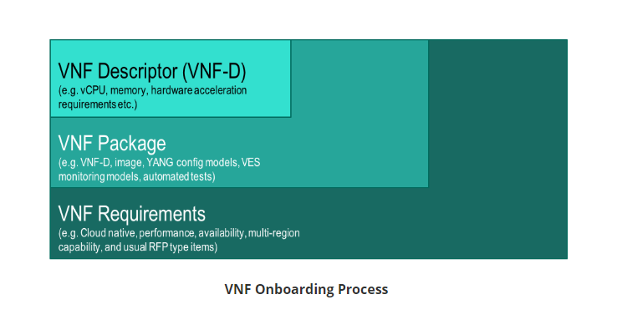
VNF Onboarding Process

Slide 21
VNF Desciptor
The VNF descriptor may be provided in OpenStack Heat or TOSCA formats.
Focusing on VNF onboarding, DCAE artifacts (analytics applications, microservices, data stores, etc.) are also onboarded through SDC
VNF descriptor (VNF-D), part of the VNF package

Slide 22
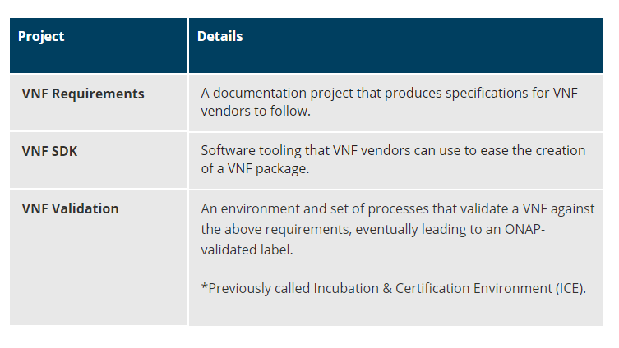
VNF Onboarding Projects

Slide 23
ONAP OSS/BSS Interface
ONAP provides API access to just about every major component. These APIs can be used for OSS/BSS integration. The types of service supported through these interfaces include:
OSS:
Capacity management
Handling major failures (e.g. at a region level)
Providing Key Performance Indicators (KPIs).
BSS:
Interface to Service Orchestrator (SO) to invoke network service instantiation along with runtime configurations, and query the status of services
Billing information, user events, customer SLA (service-level agreement) management from DCAE/data lake
Customer information management (CIM) via A&AI
SLA (availability, performance) enforcement via policy.

Slide 24
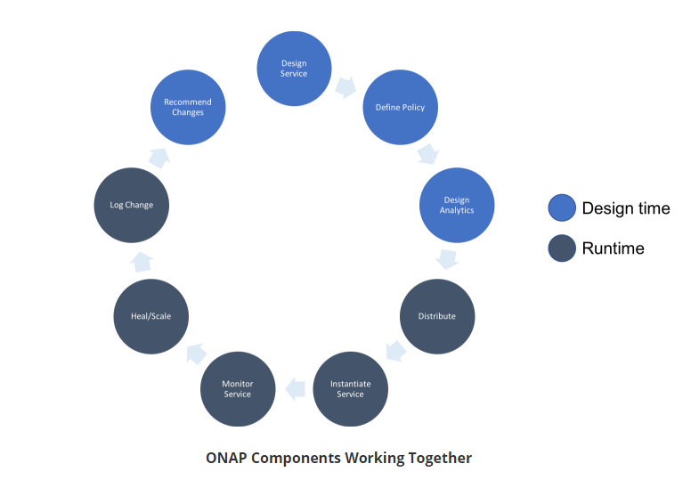
ONAP as a Whole

Slide 25
Runtime environment module
Service orchestration
Service orchestration and lifecycle management
VNF controller (VNF orchestration and lifecycle management)
Infrastructure controller (interface to the VIM, SDN controller).
Monitoring and service assurance
Data collection, analytics, and events
Storage of all active and available inventory.

Slide 26
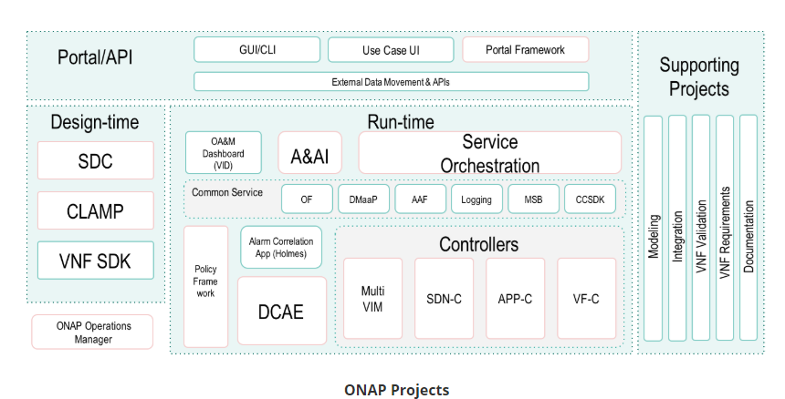
ONAP Projects

Slide 27
ONAP Lifecycle Management
ONAP itself is a cloud native application that needs orchestration and lifecycle management. The list of management tasks ranges from:
Initial deployment
Configuration
Configuration changes
Scale-out
Self healing
Updates/upgrades.

Slide 28
Cont..
ONAP can be managed with:
OpenStack There is an OpenStack Heat template to deploy and manage ONAP.
Kubernetes This option, called the ONAP Operations Manager (OOM) uses a containerized version of ONAP with Kubernetes to orchestrate and manage ONAP. A variation of this option uses TOSCA to describe the deployment instead of Helm Charts. Kubernetes is the long-term preferred option since the vCPU needs, memory footprint, and boot time get slashed by 5-6 times.

Slide 29
ONAP Design Time: Service Design and Creation (SDC)
The Service Design and Creation (SDC) project is a unified tool for design time activities such as:
Onboarding VNFs
Creating services
Creating policies
Creating workflows
Onboarding data collectors
Onboarding analytic applications
Distributing artifacts to run time.
SDC is catalog-guided, driven, extensible, and role-based (roles such as design, test, administrator, governance).

Slide 30
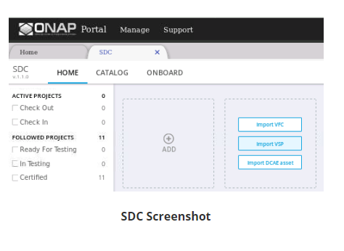
Service Design & Creation (SDC)
SDC is catalog-guided, driven, extensible, and role-based (roles such as design, test, administrator, governance).

Slide 31
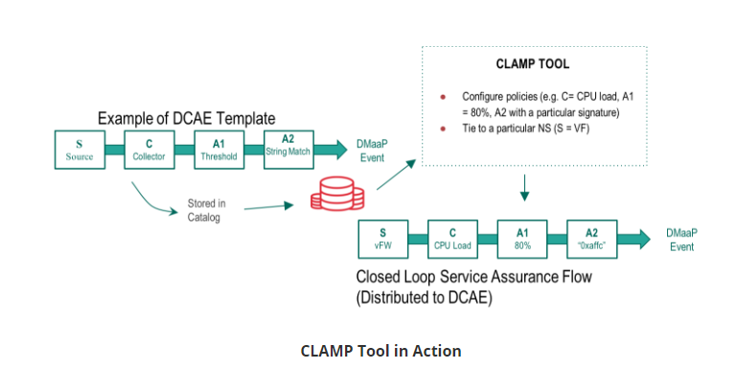
Closed Loop Automation Management Platform (CLAMP)
The Closed Loop Automation Management Platform (CLAMP) tools are used to configure policies/templates created in SDC to create closed-loop service assurance loops. The graphic below shows a template being configured with the specific collector, threshold, and string match; it is then “attached” to a network service.

Slide 32
ONAP Run Time: Service Orchestrator (SO)
The Service Orchestrator (SO) is used for real-time service creation or lifecycle management. It cuts days or weeks worth of effort to less than ten minutes. It primarily interacts with controllers, SDC and A&AI.
SO gets topologies and configurations through resource and recipe models via SDC.
SO is invoked through events, APIs from BSS or manually through VID (Virtual Infrastructure Deployment). Run time configurations for network services are also provided when SO is invoked for either initial network service deployment or post-deployment configuration change.
SO makes homing (where to place the workload) decisions, resource determination and makes the triggers management actions via one of the four controllers at its disposal. SO also handles errors and rollbacks.

Slide 33
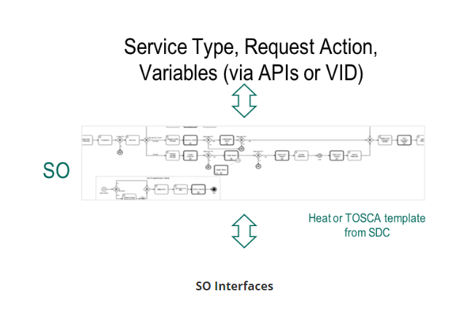
Servic Orchictrator (SO)

Slide 34
ONAP Run Time: Controllers
Four controllers :
Application Controller (APP-C)
Virtual Function Controller (VF-C)
SDN Controller (SDN-C)
MultiVIM
The controllers act under the direction of the SO, or independently, as triggered by events. As evidence, there are two methods for service orchestration in ONAP: one leverages APP-C, and the other leverages VF-C.

Slide 35
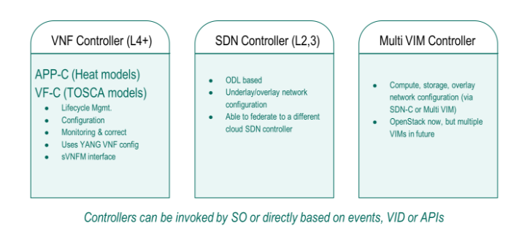
Scope of controllers

Slide 36
ONAP Run Time: Controllers: APP-C
The Application Controller (APP-C) loosely maps to the functionality of a generic VNF manager (gVNFM).
It performs lifecycle management of VNFs. Its focus is therefore on L4-L7.

Slide 37
ONAP Run Time: Controllers: VF-C
The Virtual Function Controller (VF-C) loosely maps to the functionality of a generic VNF manager (gVNFM) and can interoperate with external specific VNF managers (sVNFM) through a driver.
It accepts VNF descriptors in TOSCA format and manages initial orchestration and lifecycle management of VNFs, directly or through the sVNFM. Its focus is therefore on L4-L7.

Slide 38
ONAP Run Time: Controllers: SDN-C
The SDN Controller (SDN-C) is used to configure layers 2 and 3 networks, both physical (underlay) and virtual (overlay).
It can coexist with an external SDN Controller; often, users utilize SDN-C for inter-cloud WAN connectivity and external SDN Controllers for connectivity inside a cloud region.

Slide 39
ONAP Run Time Controllers: MultiVIM
The MultiVIM communicates with the VIM, which, in this case, is OpenStack. The term MultiVIM, for now, indicates that ONAP can connect to multiple OpenStack clouds that are from different vendors and/or different versions.
Over time, the MultiVIM is expected to support multiple VIMs, e.g. Microsoft Azure and Kubernetes.

Slide 40
ONAP Run Time: DCAE
The Data Collection, Analytics, and Events (DCAE) module is used for closed-loop automation, trending, solving chronic problems, capacity planning, service assurance, reporting, and so on.
DCAE orchestrates data collectors, microservices, analytic applications, and closed-loops. To be able to orchestrate these elements, the DCAE uses a controller called, for simplicity, the DCAE controller.
Analytic applications may be written using a well-documented Cask Data Application Platform (CDAP) software development kit (SDK). Given the model and SDK-driven nature of DCAE, it offers a self-service interface to developers, designers, and operators. DCAE interacts with SDC, Policy, and A&AI.

Slide 41
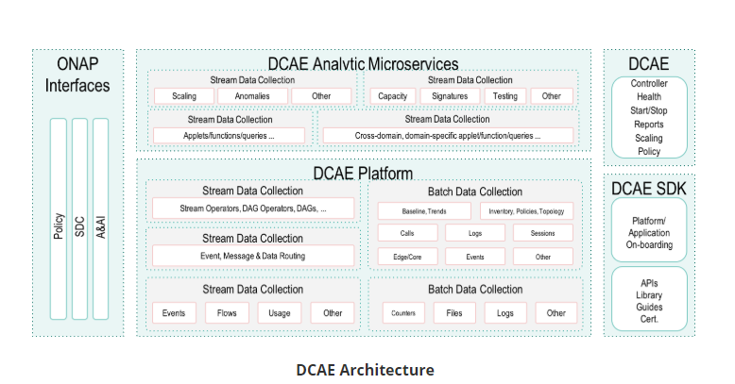
DCAE Architecture

Slide 42
ONAP Run Time: Policy
The Policy software module guides the automated system without code - purely through models that allow for dynamic changes and a self-service approach for designers (i.e. designers do not have to go through software engineers or operators to make changes). Policies can guide a wide range of activities from service instantiation, data collection, control loops, change management, and so on. Simple policies may be specified in YAML (XACML), while complex policies can be described in DROOLS, all through SDC. In the current release, there is basic policy conflict validation available, with more sophisticated validation to come in future releases.

Slide 43
pSudo Code
Below you will find three examples of simple policies (pseudo-code, not in any modeling language):
if cpu_load > 80% && duration > 5 minutes {
add 1 instance of VNF
}
if physical_memory > 15 GB {
migrate VNF
}
If memory_usage increases 5 GB or more && duration < 10 seconds {
Restart VNF
}

Slide 44
ONAP Run Time: A&AI
The Active and Available Inventory (AAI) is responsible for dynamic, real-time inventory management of virtual resources. It tracks products, services, resources - both active and available. Additionally, AAI tracks relationships by maintaining a graph database, e.g. subscriber → NS → VNFs → VMs → compute/storage/networking nodes.
AAI APIs allow discovery, registration, and auditing. Like other systems in ONAP, AAI is model-driven and extensible. As you can imagine, AAI is the single source of truth in ONAP.
It is a real-time system and, along with audit capability, it is suitable for a CI/CD flow. AAI can also maintain references to physical network functions and incorporates a sub-component called External System Registry (ESR). The ESR can register external systems like the VIM, sVNFMs, external SDN controllers, etc. AAI interacts with most ONAP components.

Slide 45
ONAP Portal/API
The ONAP Portal provides a single plane of glass for design (e.g. SDC, CLAMP) and OAM (e.g. VID, UUI that are covered in the next chapter).
It is also extensible by creating third-party applications. Third-party portal applications can choose different levels of integration - basic, target, or extended integration.
Portal applications are envisioned to be in seven areas: design, operations planning, capacity planning, technology management, technology insertion, performance management and platform management. Everything that can be done through the GUI is also available through APIs. To interact with APIs in an easy manner, ONAP also provides a command line interface (CLI).

Slide 46
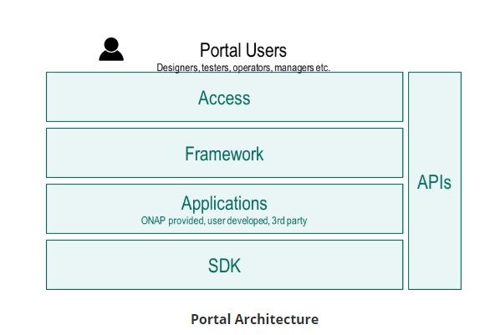
Portal Architecture

Slide 47
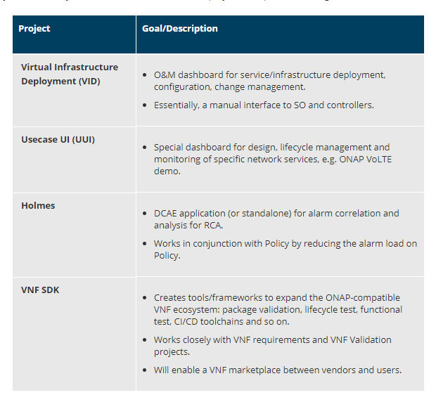
ONAP Design Time and Run Time: Other Projects

Slide 48
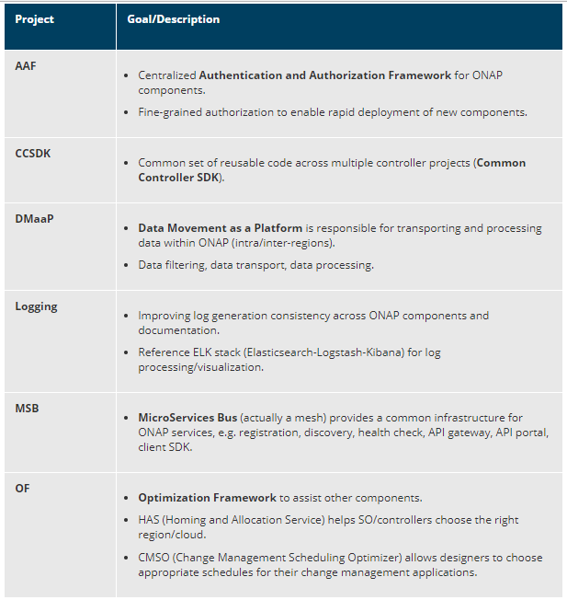
ONAP Common Services

Slide 49
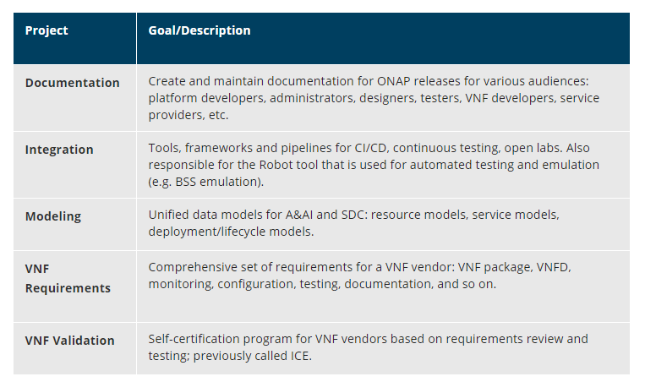
ONAP Supporting Projects

